Slide 1



The Data in Databases
Notes:
4. **The Data in Databases (15 mins)**
- Discussions on big data, database management systems, maintaining data privacy regulations, and visualising.
- Topics:
- Big Data
- Database Management Systems
- Data Privacy Regulations
- Visualising Data

Slide 2
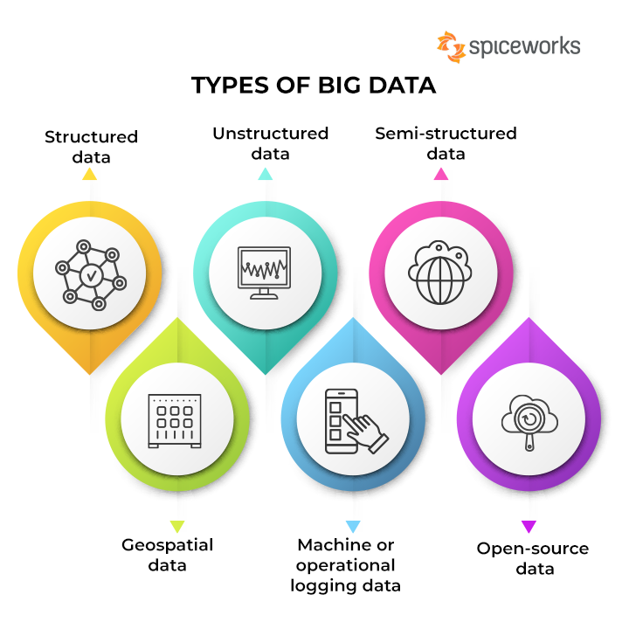
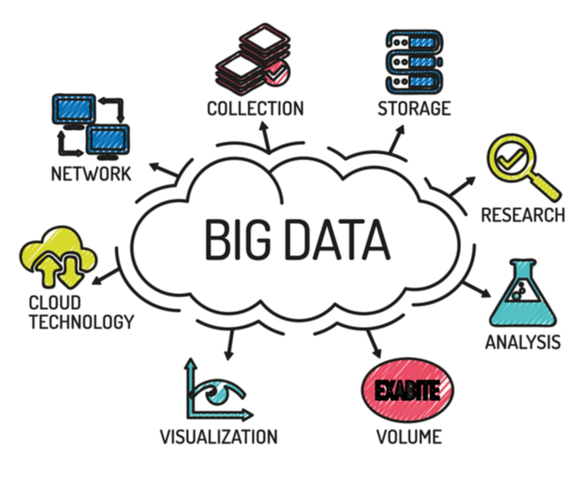
https://www.spiceworks.com/tech/big-data/articles/what-is-big-data/
https://www.linkedin.com/pulse/title-demystifying-big-data-unveiling-power-analytics-shruti-kashyap-

Slide 3
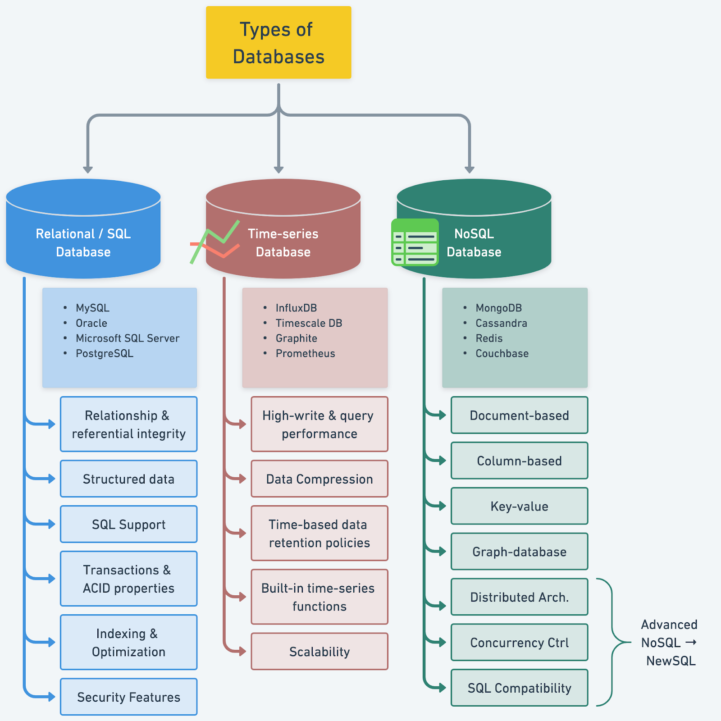
https://blog.bytebytego.com/p/understanding-database-types

